Slide 1
Element Equations
for 2-terminal elements
v
i
resistor
capacitor
inductor
memristor
q
Ø
Resistor: An element that has an algebraic equation between v and i.
Inductor: An element that has an algebraic equation between Ø and i.
Capacitor: An element that has an algebraic equation between v and q.
Memristor: An element that has an algebraic equation between Ø and q.
Algebraic equation: ....................................................................

Slide 2
2-Terminal Resistors
Linear Resistor
+
resistance, ohm
conductance, siemens
mho
v
-
i-v characteristic
v-i characteristic
Instantaneous power of a linear resistor:

Slide 3
2-Terminal Resistors
If R>0, then , passive resistor,
consumes energy.
If R<0, then , active resistor,
produces energy.
i-v characteristic
i-v characteristic
passive resistor
active resistor

Slide 4
Linearity
linear
Special Linear Resistors:
Open circuit element:
i-v characteristic
v-i characteristic

Slide 5
Short circuit element:
i-v characteristic
v-i characteristic
Is there any relation between the characteristics of these two elements?
Open circuit element:
i-v characteristic
v-i characteristic

Slide 6
Definition: (Dual Resistors)
v-i characteristics of resistor A = i-v characteristics of resistor B
Resistor A and B are dual resistors.
Nonlinear Resistor
+
I₁
v
I₂
V₁
V₂
_

Slide 7
Some Special Nonlinear Resistor
Ideal Diodes
+
Diode is conductiong:
v
Diode is reverse biased:
_
i-v characteristic
v-i characteristic
How does a diode behave when it is conducting?
How does a diode behave when it is reverse biased?

Slide 8
İdeal Diode
A more realistic diode
p-n Junction Diode (a model that is valid for low frequencies)
current and voltage of the diode
+
v
electron charge
reverse saturation current
Boltzman constant
_
Temparature (Kelvin)
Is the p-n junction diode an active or passive element?

Slide 9
Active and Passive Elements
(definitions for linear resistors)
If R>0, then , passive resistor,
consumes energy.
If R<0, then , active resistor,
produces energy.
i-v characteristic
i-v characteristic
passive resistor
active resistor

Slide 10
Active and Passive Elements
(definitions for nonlinear resistors)
Passive resistor:
Active resistor:
i-v characteristic
i-v characteristic
passive resistor
active resistor

Slide 11
Tunel Diode
+
I₁
v
slope is negative
oscillators, amplifiers
I₂
_
three possible voltages for one current
V₁
V₂
memory, switching
It is voltage-controlled, not current-controlled.
Voltage-controlled element:
Current-controlled element:

Slide 12
Independent Source
Independent voltage source
+
+
_
_
Is the independent voltage source linear?
Is the independent voltage source voltage-controlled?
Is the independent voltage source current-controlled?
Independent current source
+
v
_

Slide 13
Time-varying Resistors
v-i characteristic of a time-varying resistor varies for different times.
In other words f(v,i,t)=0 depends on time.
Linear time-varying resistor
+
v
_
i
Switch
+
S(t)
v
S(t)
t
v
_
Notes:
Anahtar elemanı bu dokumanlarda eksik

Slide 14
1-port (or 2-terminal) elements
consisting of 2-terminal resistors
i
i
+
i: port corrent
v: port voltage
+
+
N
1-kapılısı
N
1-kapılısı
v
v
_
How can we find the element equation (or the v-i characteristic)?
_
Resistors connected in series
Element equations:
(current-controlled)
i
d₁
i₁
+
+
R₁
v₁
_
KCL
KVL
v
1. node
node sequence 1-2-3-1
d₂
i₂
+
2. node
R₂
v₂
_
_
N
d₃

Slide 15
Aim: to find the current-controlled element equation for the 1-port:
KVL
+
KCL
Result:
KCL Port current is the same as the current of a resistor.
KGY Port voltage is the sum of the voltages of resistors.
Since the resistors in series are current-controlled the 1-port is also current-controlled.

Slide 16
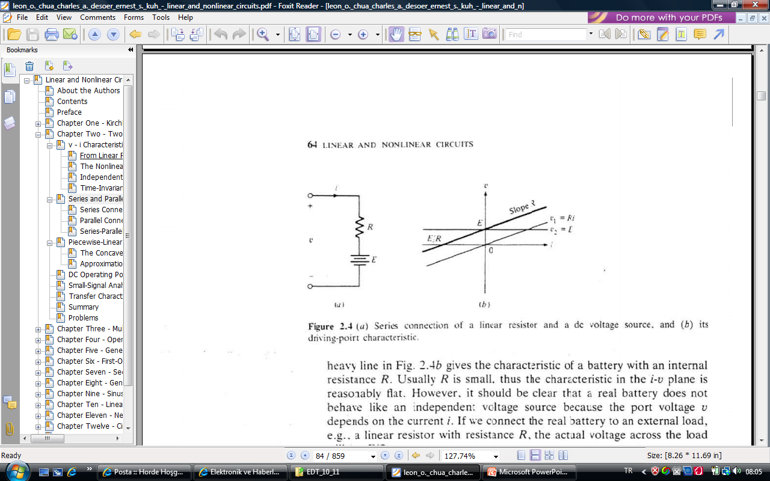
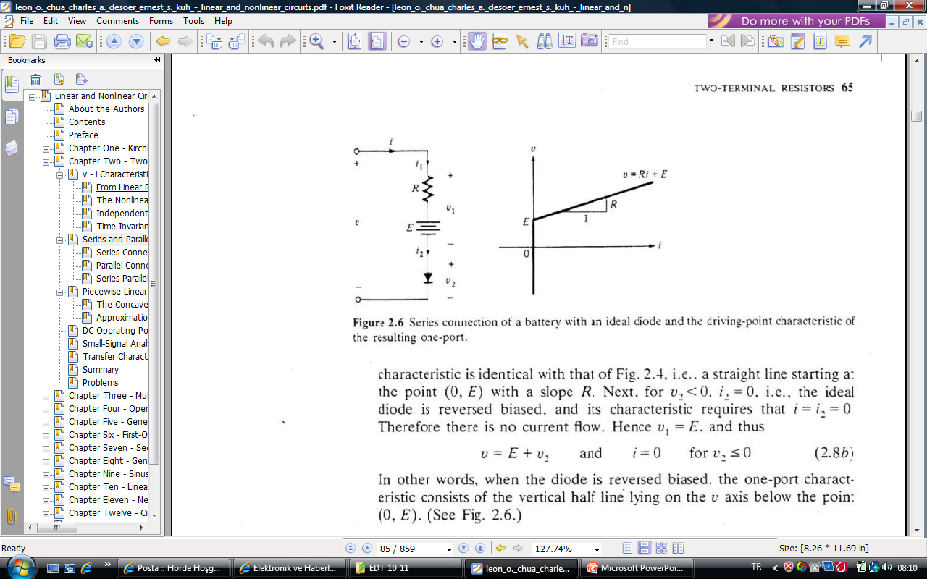
Example 1:
Obtain the element equation for the 1-port.
Example 2:
Obtain the element equation for the 1-port.
L.O. Chua, C.A. Desoer, S.E. Kuh. “Linear and Nonlinear Circuits”, Mc.Graw Hill, 1987, New York

Slide 17
Resistors connected in series
Element equations:
(voltage-controlled)
i
d₁
+
i₁
i₂
+
+
v
v₁
R₁
v₂
KVL:
R₂
_
_
_
KCL:
N
d₂
Since the resistors in series are current-controlled the 1-port is also current-controlled.
Aim: to find the voltage-controlled element equation for the 1-port:
KCL
+
EE
+
KVL

Slide 18
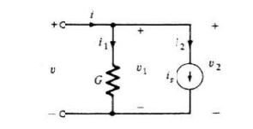
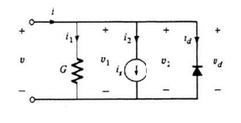
Example 3:
Obtain the element equation for the 1-port.
Example 4:
Obtain the element equation for the 1-port.
L.O. Chua, C.A. Desoer, S.E. Kuh. “Linear and Nonlinear Circuits”, Mc.Graw Hill, 1987, New York

Slide 19
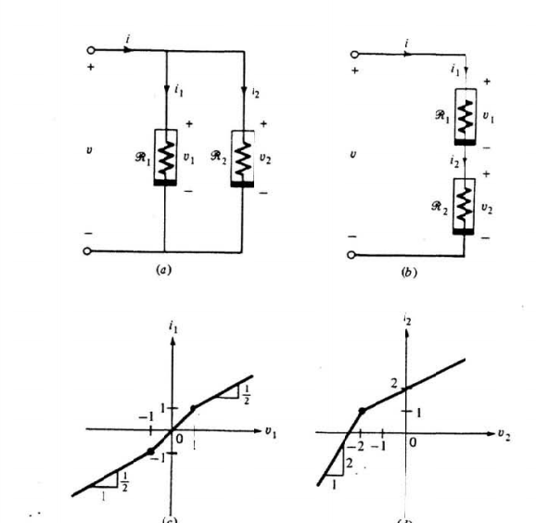
Other examples:
L.O. Chua, C.A. Desoer, S.E. Kuh. “Linear and Nonlinear Circuits”, Mc.Graw Hill, 1987, New York

